Slide 1
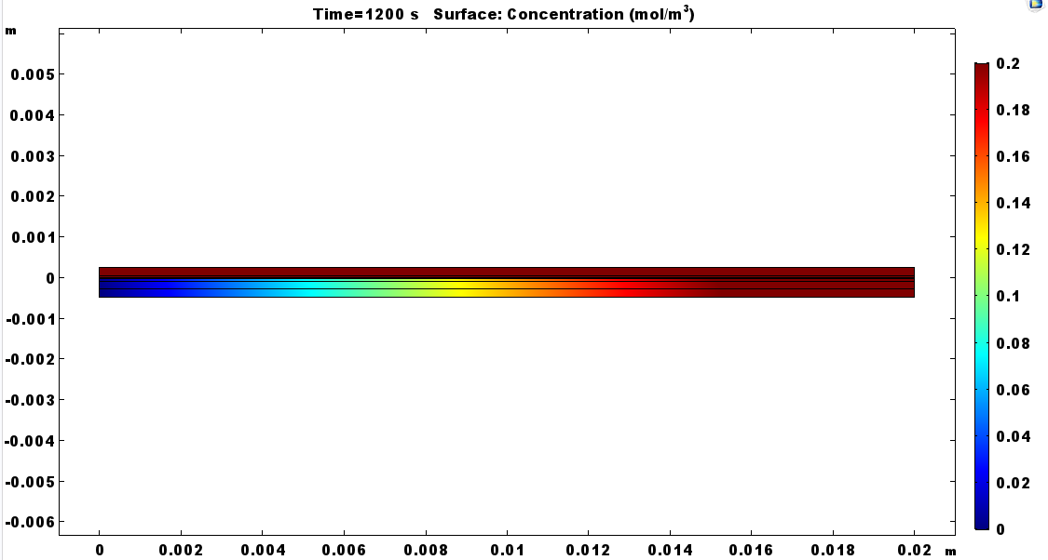
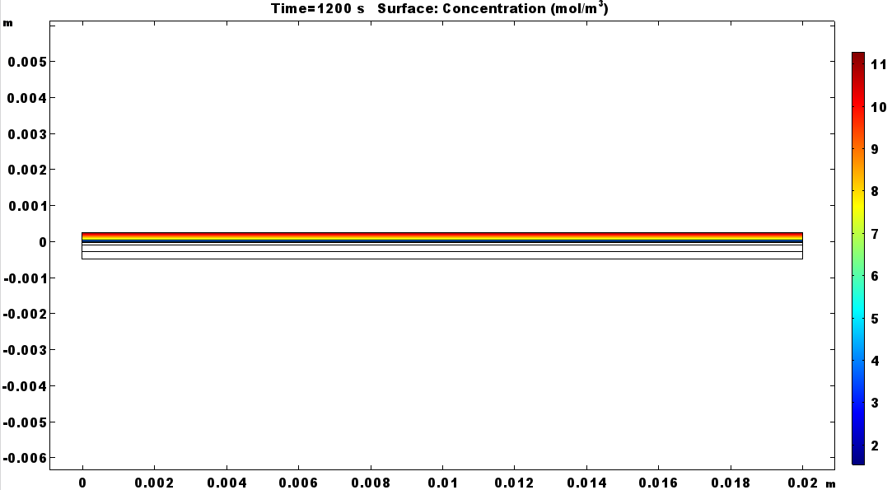
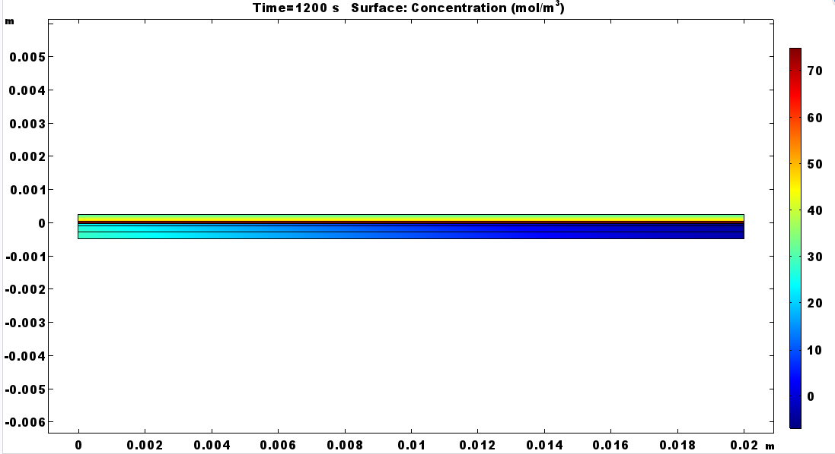
Nitrogen Model
Anode channel was added to Litster group’s COMSOL MEA model
Liquid water transport turned off to accelerate simulation
Nitrogen transport through porous layers added
Dissolved nitrogen through membrane added
Nitrogen advection in channel added
Captures along the channel nitrogen accumulation
Recirculation to be added next
Nitrogen
Cathode side
Anode side
H2 flow direction
Oxygen concentration
Water vapor

